Slide 1
Extracting Causal Relations from Electronics & Supply Chain News
Fiona Anting Tan Institute of Data Science National University of Singapore, Singapore tan.f@u.nus.edu
19th Jan 2023
Notes:
To extract the hidden pattern in data to understand the interrelation between factors—in future to establish causality

Slide 2
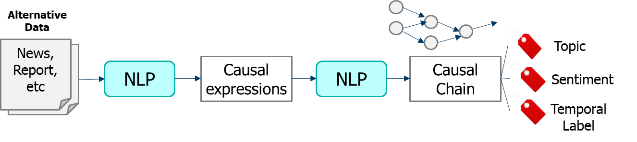
We wish to build and investigate causal graphs for summarization and hypothesis generation.
OVERVIEW
Build: Using NLP tools and store onto (graph) databases
Investigate: Based on business requirements
Electronics/Supply-Chain News
Summarization: Collect relations in supply-chain news across time
Hypothesis generation: Predict outcomes based on current event
Source: Panasonic Industry
Notes:
In this project, we wish to build and investigate causal graphs for summarization and hypothesis generation.
In a sense, most of the fundamental tools we are building based on NLP technologies and graph databases are industry agnostic. The investigation and application is the main area that requires tweaking based on business requirements.
In this project, we are working with Electronics and Supply Chain news. The immediate use cases to summarize causal relations from such news is to (1) summarize current happenings quickly, and (2) using the current chain of events, predict possible outcomes. Such a prediction tool can then be used to send alerts to users for further analysis or action if needed.

Slide 3
NLP Tools
METHODOLOGY
POS / Dependency Parsing with Stanza
Causal Sentence Classification with UniCausal
Cause-Effect Span Detection with UniCausal
Frames Parsing with OpenSESAME
Cause-Effect Argument Detection with adapted CauseNet
Example Sentence
This cuts both ways – investments now will lead to more green jobs in the coming years .

Slide 4
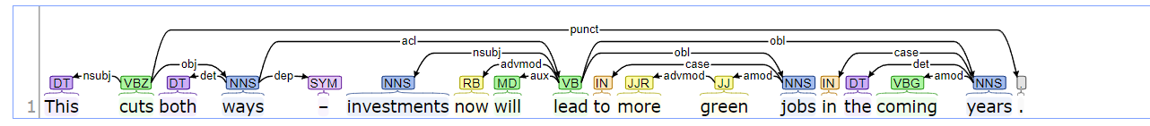
NLP Tools
METHODOLOGY - NLP TOOLS
POS / Dependency Parsing with Stanza
Notes:
cd "C:\Users\effbl\stanza_corenlp\stanford-corenlp-4.2.2"
java -mx4g -cp "*" edu.stanford.nlp.pipeline.StanfordCoreNLPServer -preload tokenize,ssplit,pos,lemma,ner,parse,depparse -status_port 9000 -port 9000 -timeout 90000

Slide 5
NLP Tools
METHODOLOGY - NLP TOOLS
Causal Sentence Classification with UniCausal
Cause-Effect Span Detection with UniCausal
CAUSAL
<CAUSE>This cuts both ways – investments now will</CAUSE> lead to <EFFECT>more green jobs in the coming years .</EFFECT>
Notes:
Cause in pink; Effect in green
Can try more sentences here:
https://huggingface.co/tanfiona/unicausal-seq-baseline
https://huggingface.co/tanfiona/unicausal-tok-baseline
We are implementing models that surpass our current baseline for Span Detection as we speak.
Potential issue is there are some types of causality (Purpose types) that might not fit in your scope of causality.

Slide 6
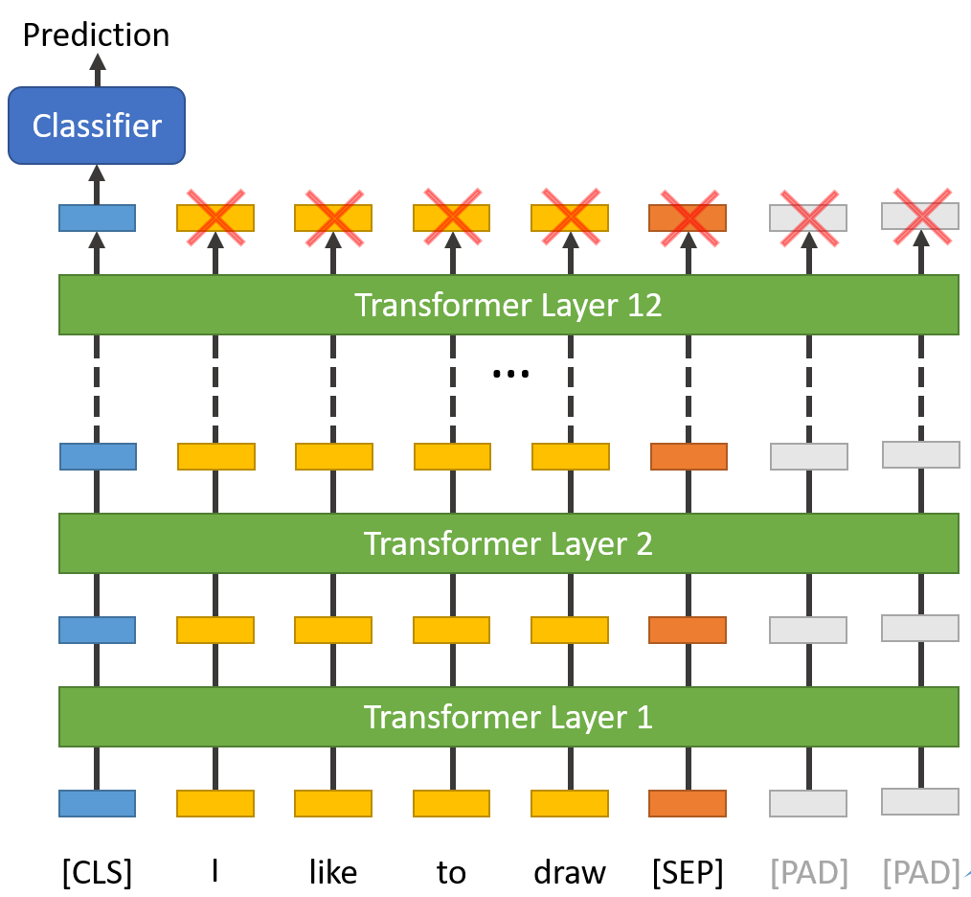
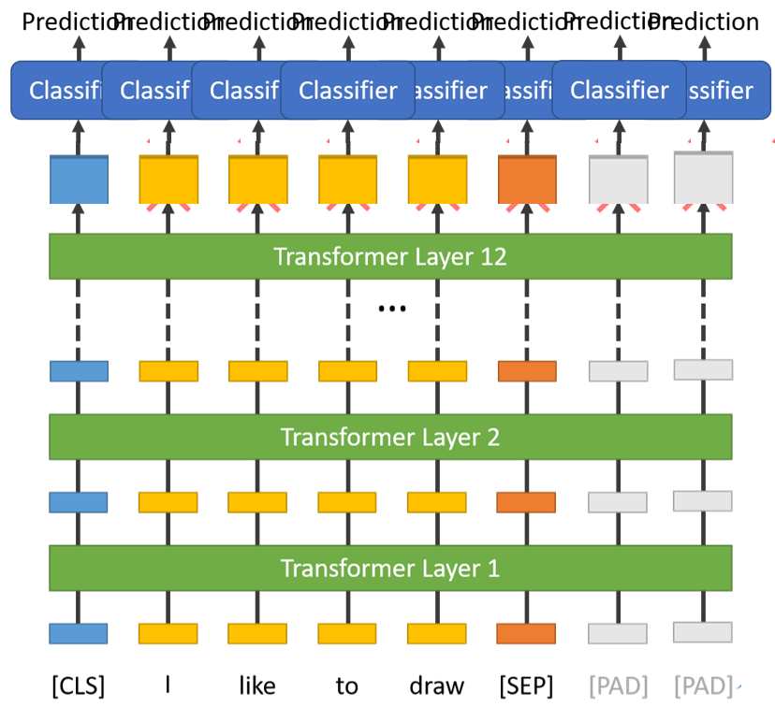
NLP Tools
METHODOLOGY - NLP TOOLS
Causal Sentence Classification
Cause-Effect Span Detection
Source: https://medium.com/@antoine.louis/a-brief-history-of-natural-language-processing-part-2-f5e575e8e37
Both tools rely on BERT-based models, and have been trained on 6 causal text mining datasets.

Slide 7
NLP Tools
METHODOLOGY - NLP TOOLS
Frames Parsing with OpenSESAME
<S-Agent>This</S-Agent> [Cause_change_of_position_on_a_scale]cuts <B-Item>both ways – investments now will lead to more green jobs in the coming years .
This cuts both [Means]<S-Means>ways</S-Means> – investments now will lead to more green jobs in the coming years .
This cuts <B-Trajector_event>both ways – investments [Temporal_collocation]now will lead to more green jobs in the coming years .
This cuts both ways – investments now will [Leadership]lead <B-Place>to more green jobs in the coming years .
This cuts both ways – investments now will lead to more [Color]<S-Color>green</S-Color> <S-Entity>jobs</S-Entity> in the coming years .
This cuts both ways – investments now will lead to <B-Compensation>more green [Being_employed]jobs in the coming years .
This cuts both ways – investments now will lead to more green jobs in the [Arriving]coming <S-Theme>years</S-Theme> .
This cuts both ways – investments now will lead to more green jobs in the <S-Relative_time>coming</S-Relative_time> [Calendric_unit]years .
Notes:
A frame-semantic parser for automatically detecting FrameNet frames and their frame-elements from sentences.
The FrameNet project is building a lexical database of English that is both human- and machine-readable, based on annotating examples of how words are used in actual texts.

Slide 8
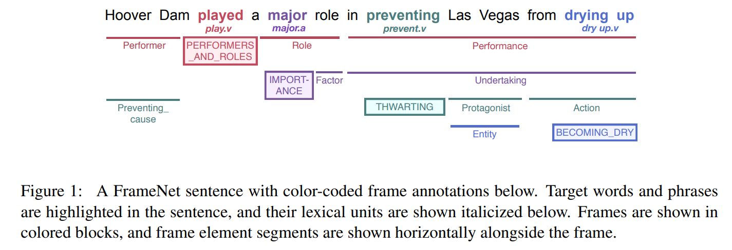
NLP Tools
METHODOLOGY - NLP TOOLS
OpenSESAME model is based on softmax-margin segmental BiLSTMs.
Stepwise approach that uses outputs from the previous step as inputs, in the following order:
Targets
Frames
Arguments
Source: https://arxiv.org/pdf/1706.09528.pdf
Notes:
Target: verb
Frames: meaning of the verb
Argument: words (BIOS) tied to frames

Slide 9
NLP Tools
METHODOLOGY - NLP TOOLS
Cause-Effect Argument Detection with adapted CauseNet
Example Sentence
This cuts both ways – investments now will lead to more green jobs in the coming years .
Patterns Detected
[[cause]]/N +parataxis lead/VB +nmod:to [[effect]]/N
investments --> jobs
[[cause]]/N -nmod:in lead/VB +nmod:to [[effect]]/N
years --> jobs
Notes:
Based on [NOUN] VERB [NOUN] patterns

Slide 10

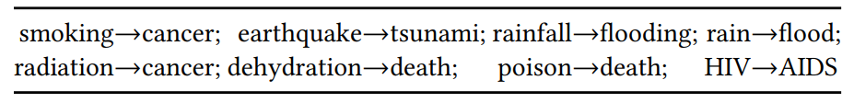
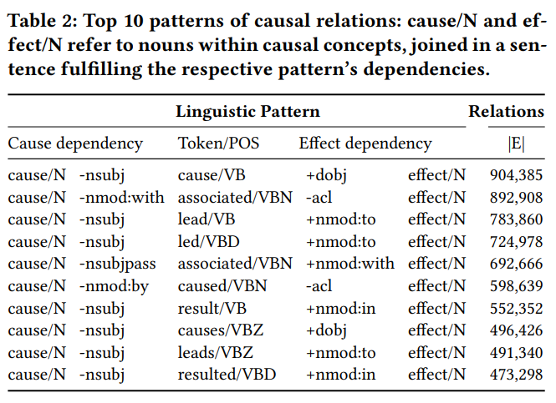
NLP Tools
METHODOLOGY - NLP TOOLS
Cause-Effect Argument Detection with adapted CauseNet
Bootstrapping approach:
Set a few common causal relations as seeds
Mine linguistic patterns of causality based on the shortest path between nouns
Filter by support
Apply patterns to find new causal relations
Stefan Heindorf, Yan Scholten, Henning Wachsmuth, Axel-Cyrille Ngonga Ngomo, Martin Potthast: CauseNet: Towards a Causality Graph Extracted from the Web. CIKM 2020: 3023-3030
Notes:
Based on [NOUN] VERB [NOUN] patterns
To extract causal relations from the web at scale, the authors used the ClueWeb12 web crawl, which comprises about 733,019,372 English web pages crawled between February and May
They used a minimally supervised bootstrapping approach that only requires a few initial training samples.
The bootstrapping process starts with a small set of well-known causal relations as seeds (A→B stands for “A causes B”) shown in the first table.
Not all newfound patterns and causal relations qualify as additional seeds for the next iteration. They are selected based on a support criterion, which measures the number of unique patterns that extract the seed’s causal relation.
Lastly, with all the additional patterns, we can extract even more Cause-Effect arguments.

Slide 11
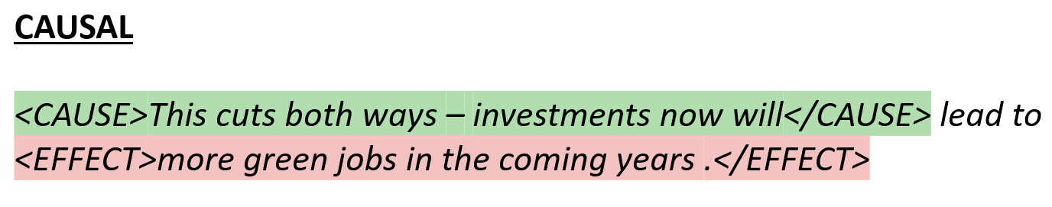
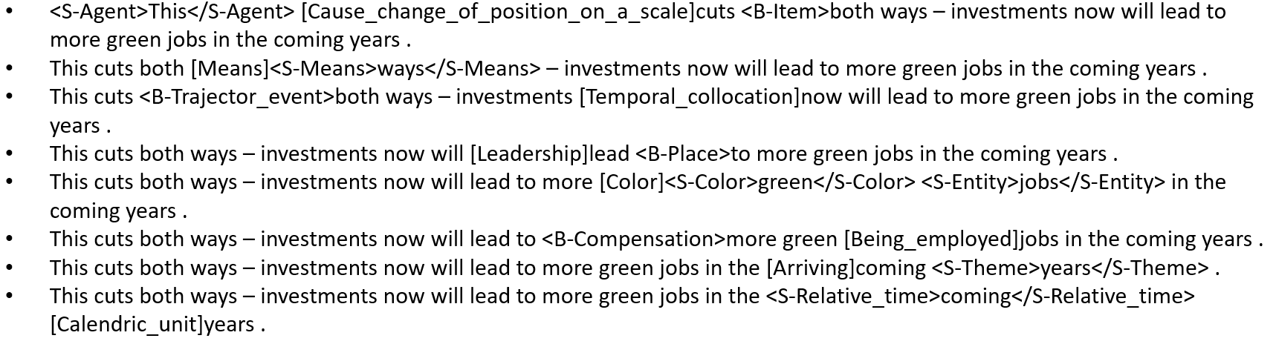
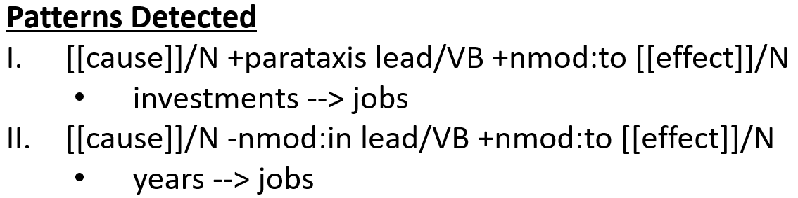
NLP Tools
METHODOLOGY
This cuts both ways – investments now will lead to more green jobs in the coming years .
POS / Dependency Parsing with Stanza
Causal Sentence Classification with UniCausal
Cause-Effect Span Detection with UniCausal
Frames Parsing with OpenSESAME
Cause-Effect Argument Detection with adapted CauseNet
Notes:
Try out:
Strict rules: # 2 = Causal, # 3 overlaps with # 5, create other sanity checks with # 1 & # 4
Nothing much might be extracted
Relaxed rules: # 3 pairs if # 2 = Causal / # 5 any pairs detected / # 4 if verb type is Cause
Gibberish might be extracted

Slide 12
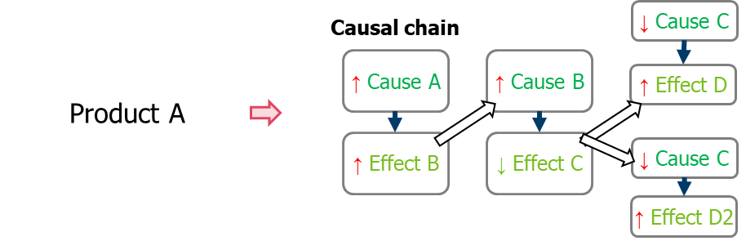
Discussion
Causal relations curation rules: All, add levels to the CE extracted
Prototype data size: Full dataset, or split by quarters
Evaluation strategy: TBD
Product identification:
Temporal & sentiment aspect
Importance of other relation types
Cross-sentence relations
Source: Panasonic Industry
Notes:
Other details:
6384 unique articles, 55354 sentences in total to work with.
Should we prototype with all the articles or just a subset?
Are you sure causal relations are the only thing worth analysing? If the aim is to survey current trends and news, I think we need more than causal relations. It’s more of summary, highlight impactful sentences (maybe sentences with a lot of events), and maybe the causal part is a small point to note.
Multi-sentence issues
Issues after curating relations (can discuss later):
Synonyms/co-reference resolution/generalization issues

Slide 13
Applied research publication venues:
JAN - NAACL Industry Track: https://2022.naacl.org/calls/industry/
FEB - KDD Applied Data Science Track: https://kdd.org/kdd2022/cfpAppliedDS.html
JUN/JUL - EMNLP Industry Track: https://2022.emnlp.org/calls/industry_track/
AUG - Innovative Applications of Artificial Intelligence (IAAI): https://aaai.org/Conferences/AAAI-23/iaai-23-call/
Notes:
1. Create a Causal Chain (1 to 5 above steps) tuned to Panasonic Database
2. Add time aspect to the Causal Chain Time recognition NLP
3. Add Sentiment aspect to the Causal Chain Based on pre-defined sentiment model

Slide 14
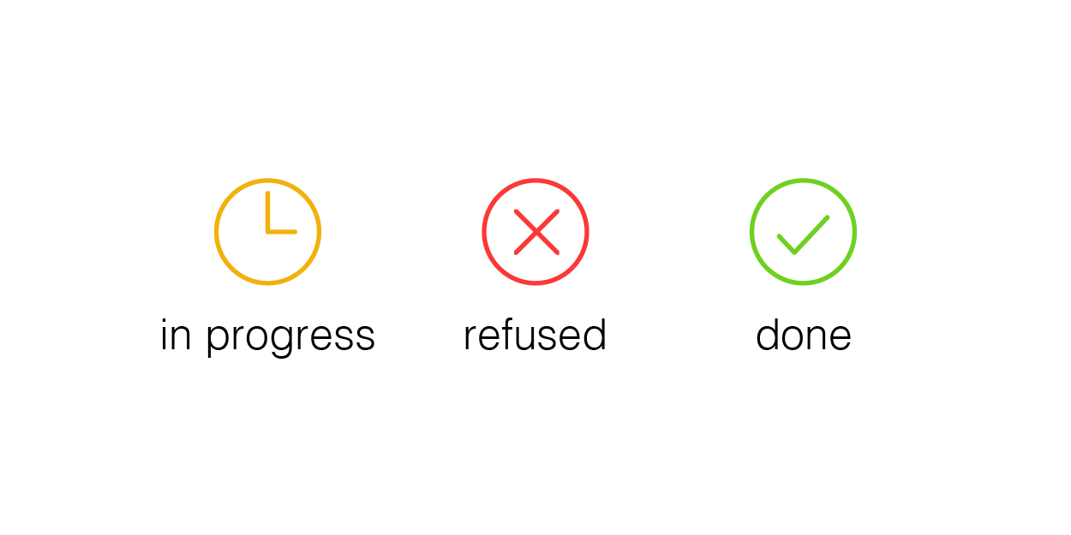
The Steps
OVERVIEW
Extraction:
Use models and datasets from UniCausal
Representation:
Remove specific causal relations,
Perform co-reference resolution,
Apply generalization procedure,
Handle negations
Application: See each domain

Slide 15
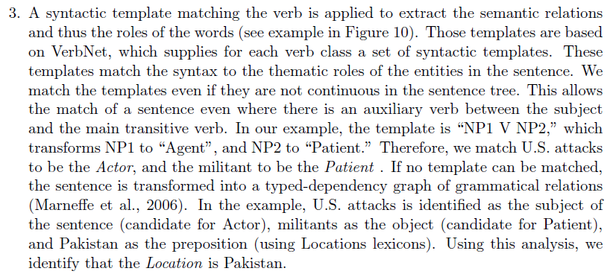
Where I am at now…
Work with more data
Add rule-based extraction (Heindorf et al., 2020)
Implement ambiguity-frequency levels for ranking (Girju et al., 2002)
Continual effort: Improve extraction models
Extraction:
Identify noun phrases,
Causal pair classification
Simple co-reference resolution
Representation:
Format causal pairs into graph
…
Add negations/ direction/ strength
Generalize <> Remove specific causal relations
Extract events instead of noun phrases? Both have its merits
Consider strongly-connected graph
[See DEMO]

Slide 16
CONCLUSION

